Slide 1
10.6 Surface Integrals

Slide 2
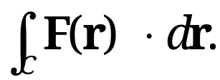
10.6 Surface Integrals
Review of Definition of Line Integrals
In a line integral, we integrate the integrand, a vector function F(∙), along a curve C in a plane or in space
Line integral requires representing the curve C by a parametric representation
r(t) = [x(t), y(t), z(t)] = x(t)i + y(t)j + z(t)k (a ≤ t ≤ b),
with r(t) being differentiable
Definition of line integral
dot product
Section 10.6 p<number>

Slide 3
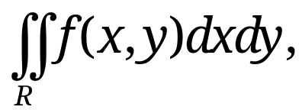
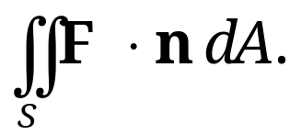
10.6 Surface Integrals
Definition of Surface Integrals
Surface integral is a generalization of a double integral
which integrates the integrand, the scalar function f(x, y), over a closed bounded region R in the xy-plane
In a surface integral, we shall integrate the integrand, a vector function F(∙), over a surface S in space
This requires representing the surface S by a parametric representation (as in Sec. 10.5)
(1) r(u, v) = [x(u, v), y(u, v), z(u, v)] = x(u, v)i + y(u, v)j + z(u, v)k,
where (u, v) varies over a region R in the uv-plane.
dot product
Section 10.6 p<number>

Slide 4
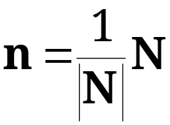
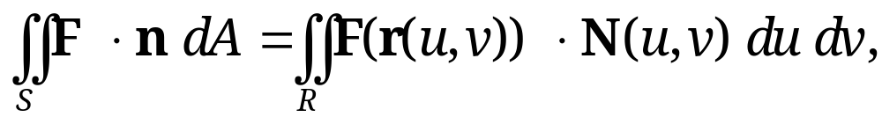
10.6 Surface Integrals
Definition of Surface Integrals (continued)
In addition, we require S to be piecewise smooth so that it has a normal vector
(2) N = r_{u} × r_{v} and a unit normal vector
at every point (except perhaps for some edges or cusps, as for a cube or cone).
A surface integral of a vector function F(r) over a surface S, represented by r(u, v) with (u, v) varying over a region R in the uv-plane, is defined by
(3)
where by (2), N(u, v) = r_{u} × r_{v} and n = N /|N|.
dot product
Section 10.6 p<number>

Slide 5
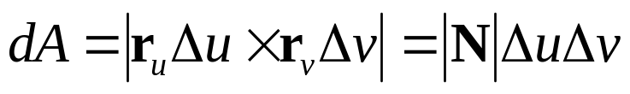







Interpretation of Surface Integrals
10.6 Surface Integrals
Consider the increment element of area of S at P: it has
A unit normal vector with N = r_{u} × r_{v}
The area of parallelogram:
n
dA
•
P
S
z
y
x
Section 10.6 p<number>

Slide 6
10.6 Surface Integrals
Interpretation of Surface Integrals (continued)
Hence, dA = |N| du dv is the element of area of S, and
(3*) n dA = n |N| du dv = N du dv.
F ⋅ n is the normal component of F
This integral arises naturally in flow
problems, and gives the flux across S when
F = ρv, where ρ and v are fluid density and velocity field
  (v ⋅ n)dA is fluid volume passing through dA per second
  (F ⋅ n)dA=(ρ v ⋅ n)dA is the fluid mass passing through dA per second
  Summing over all increment elements yields the flux across surface S
Thus, we also call the surface integral (3) the flux integral
n
F
Increment
element dA
Section 10.6 p<number>

Slide 7
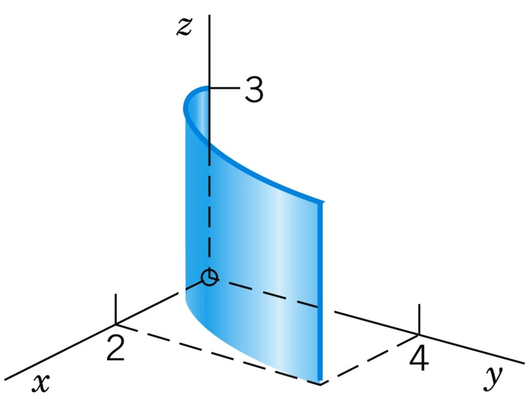
10.6 Surface Integrals
EXAMPLE 1
Flux Through a Surface
Velocity vector is v = F = [3z², 6, 6xz] in meters/sec.
With ρ = 1 g/cm³ = 1 ton/m³ for water, F = ρv = [3z², 6, 6xz] in ton /m² /sec.
Compute the flux of water through the parabolic cylinder S: y = x², 0 ≤ x ≤ 2, 0 ≤ z ≤ 3 (unit in meter, Fig. 245)
Fig. 245. Surface S in Example 1
v
N
R
v
u
0 2
u
Region of u and v
Section 10.6 p<number>

Slide 8
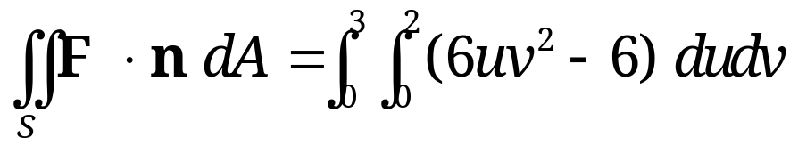
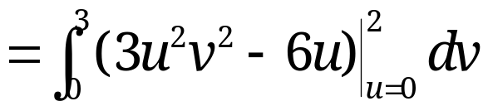
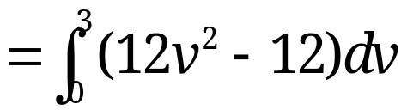
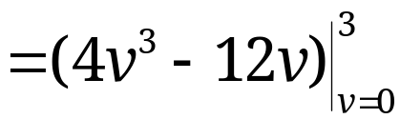

10.6 Surface Integrals
Solution:
Parametrize: x = u and z = v, we have y = x² = u². Hence, Surface S: r = [u, u², v] (0 ≤ u ≤ 2, 0 ≤ v ≤ 3).
By differentiation and calculating the cross product,
N = r_{u} × r_{v} = [1, 2u, 0] × [0, 0, 1] = [2u, –1, 0].
Expressing F in terms of u and v,
F(r (u, v))= [3v², 6, 6uv].
With F(r) ⋅ N = 6uv² – 6, the flux integral is
Section 10.6 p<number>

Slide 9
10.6 Surface Integrals
Remarks:
The N direction is given by N = [2u, –1, 0] as shown
Surface integral measures the flow of water from right to left in Fig. 245
The x-component of F is positive, the flow goes from right to left, leading to positive contribution to integral
The y-component of F is positive, so that in Fig. 245 the flow goes from left to right, leading to negative contribution to integral
The z-component of F does not pass through the surface at all.
Section 10.6 p<number>

Slide 10
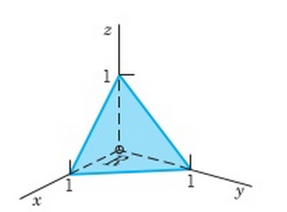
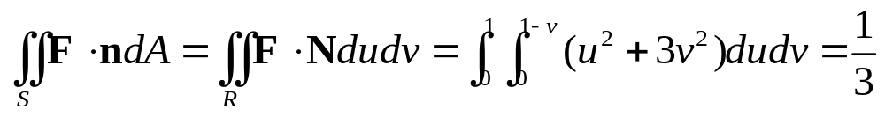
EXAMPLE 2
10.6 Surface Integrals
Evaluate surface integral (3) when F = [x², 0, 3y²] and surface S is defined by x+y+z=1 in the first octant
Fig. 246. Surface S in Example 2
Parametrize: x = u and y = v, we have z=1-u-v. Hence, Surface S: r = [u, v, 1-u-v] (0 ≤ u ≤ 1-v, 0 ≤ v ≤ 1).
N = r_{u} × r_{v} = [1, 0, -1] × [0, 1, -1] = [1, 1, 1]
F in terms of u and v: F(r) = [u², 0, 3v²]
F(r) ⋅ N = u² + 3v²
v
R
0 1
u
Region of u and v
Section 10.6 p<number>

Slide 11
10.6 Surface Integrals
Orientation of Surfaces
Value of surface integral defined above depends on the choice of the unit normal vector n
  If we choose –n instead of n, then it yields a negative sign on the result
Such an integral is an integral over an oriented surface S, i.e., over a surface S on which we have chosen one of the two possible unit normal vectors in a continuous fashion
Theorem 1
Change of Orientation in a Surface Integral
The replacement of n by –n (hence of N by –N) corresponds to the multiplication of the integral in (3) by –1.
Section 10.6 p<number>

Slide 12
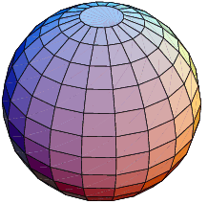
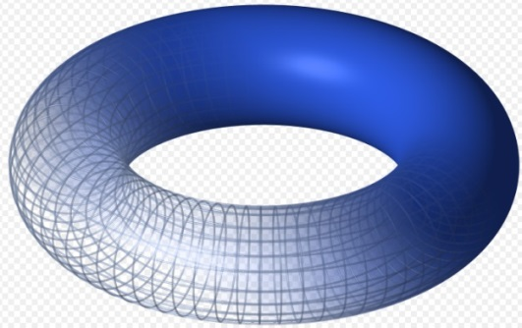
Orientation of Smooth Surfaces
10.6 Surface Integrals
A surface S is called a smooth surface if its surface normal depends continuously on the points of S
A smooth surface S is orientable if the positive normal direction, when given at an arbitrary point P₀ of S, can be continued in a unique and continuous way to the entire surface; otherwise, it is nonorientable.
An orientable surface has two sides
In practical applications, many surfaces are smooth and orientable, e.g., spheres, planes, tori
Sphere
Torus
Section 10.6 p<number>

Slide 13
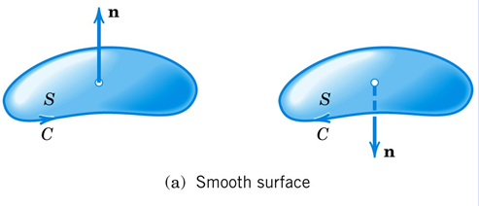
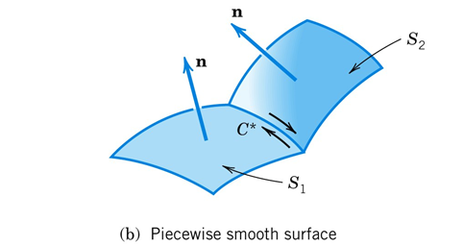
10.6 Surface Integrals
Orientation of Piecewise Smooth Surfaces
Fig. 247. Orientation of a surface
For a smooth orientable surface S with boundary curve C we may associate with each of the two possible orientations of S an orientation of C.
A surface is piecewise smooth if it consists of finitely many smooth surfaces
A piecewise smooth surface S is orientable if each smooth piece of S can be oriented so that along each common boundary curve C* of two pieces S₁ and S₂, the positive direction of C* relative to S₁ is opposite to the direction of C* relative to S₂.
Section 10.6 p<number>

Slide 14
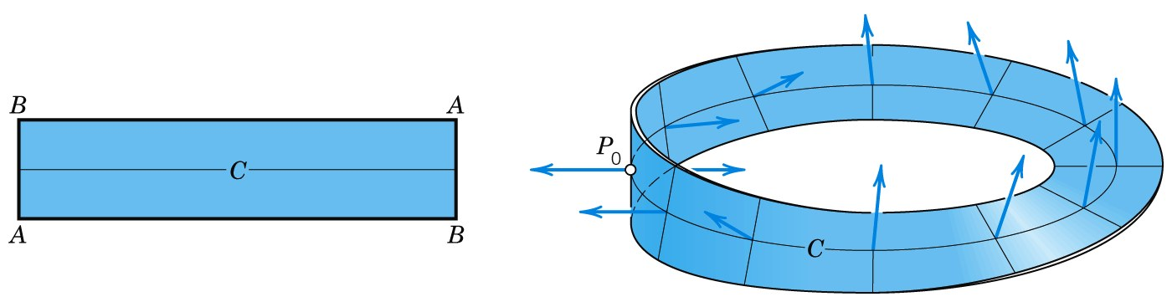
10.6 Surface Integrals
Nonorientable Surfaces
A sufficiently small piece of a smooth surface is always orientable, but this may not hold for the entire surface
Möbius strip
  Standard example of nonorientable surfaces
  It has only one side!
Fig. 248. Möbius strip
Section 10.6 p<number>

Slide 15
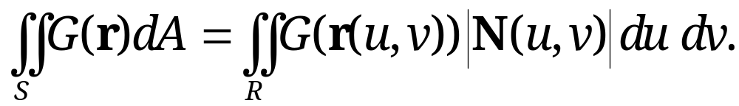
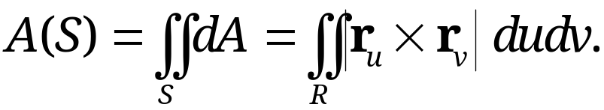
10.6 Surface Integrals
Surface Integrals Without Regard to Orientation
Integrand is a scalar function G(r)
(6)
Here dA = |N| du dv =|r_{u} × r_{v}| is the element of area of the surface S and we disregard the orientation
If G(r) is the mass density of S, then the integral (6) gives the total mass of surface S
If G(r) = 1, then (6) gives the area A(S) of surface S,
Section 10.6 p<number>

Slide 16
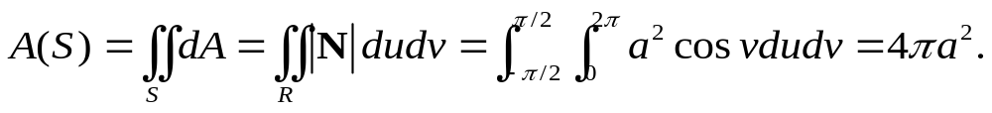
10.6 Surface Integrals
EXAMPLE 3 Area of a Sphere
A sphere x² + y² + z² = a² can be parametrized by
r(u, v) = a cos v cos u i + a cos v sin u j + a sin v k
with (u, v) varies in the region R: 0 ≤ u ≤ 2π, –π/2 ≤ v ≤ π/2.
Then,
r_{u}(u, v) = -a cos v sin u i + a cos v cos u j + 0k
r_{v}(u, v) = -a sin v cos u i - a sinv sin u j + a cos v k
N(u, v) = a² cos² v cos u i + a² cos² v sin u j + a² cos v sin v k
|N(u, v)| = a² cos v
The area of the sphere is given by
Section 10.6 p<number>

Slide 17
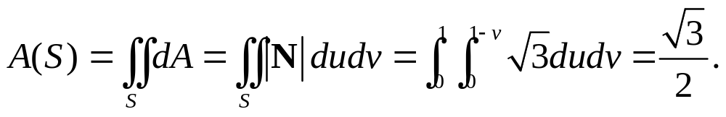
EXERCISE 1
10.6 Surface Integrals
Evaluate the area of surface S defined by x+y+z=1 in the first octant:
Fig. 246. Surface S in Example 2
Solution
  Parametrize: x = u and y = v, we have z=1-u-v. Hence, Surface S: r = [u, v, 1-u-v] (0 ≤ u ≤ 1-v, 0 ≤ v ≤ 1).
  N = r_{u} × r_{v} = [1, 0, -1] × [0, 1, -1] = [1, 1, 1]
  Thus, the area A(S) is given by
v
R
0 1
u
Region of u and v
Section 10.6 p<number>

Slide 18
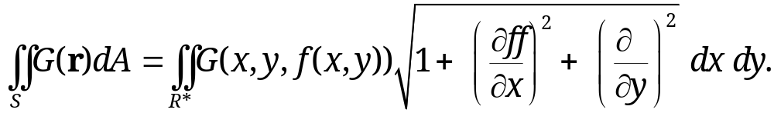
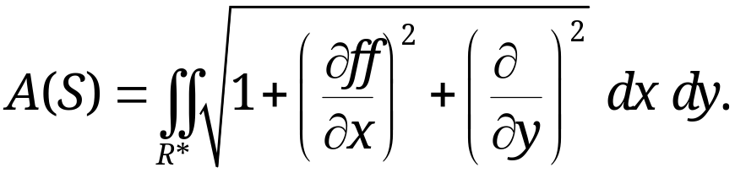
10.6 Surface Integrals
For Surface S with Representation z = f(x, y)
Choose the parameters: u = x, v = y, then r = [u, v, f ]; and
With f_{u} = f_{x} and f_{v} = f_{y} , integral (6) becomes
With G = 1, the area A(S) of S is given by:
where R* is the projection of S into the xy-plane
Section 10.6 p<number>

Slide 19
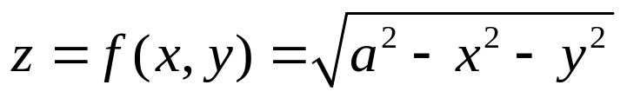
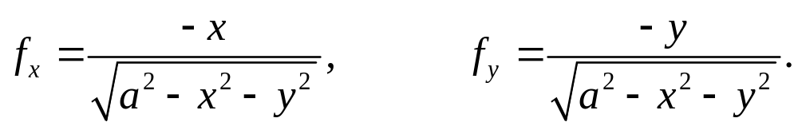
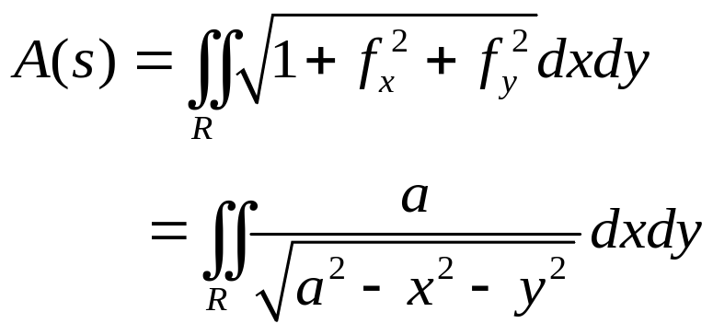
10.6 Surface Integrals
EXAMPLE 4 Area of a Sphere (Revisited)
The sphere x² + y² + z² = a² can be expressed as
Then,
With G(r)=1, area is given by
where integration of x and y is over the region R
(upper half only)
f(x,y)
R
y
x
Section 10.6 p<number>

Slide 20

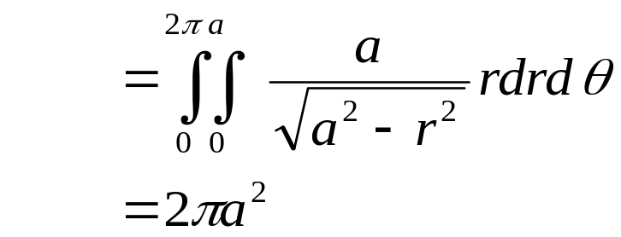
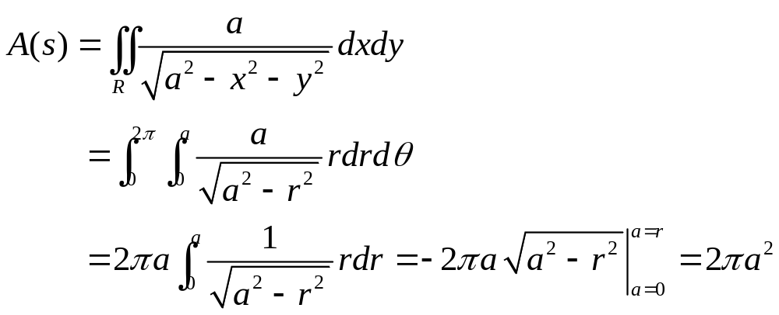
10.6 Surface Integrals
EXAMPLE 4 Area of a Sphere (Revisited) (continued)
With change of variables to calculate integration:
with 0 ≤ r ≤ a and 0 ≤ θ ≤ 2π to cover the region R
Hence,
The total area of the sphere = 2 × upper half = 4π a² (same result as surface integral shown before)
Section 10.6 p<number>

Slide 21
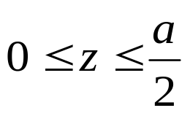


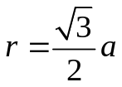

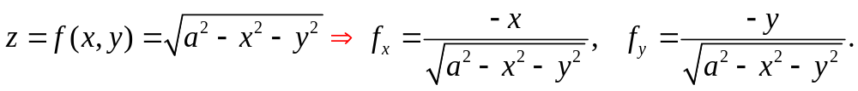
10.6 Surface Integrals
EXERCISE 2: Area of Part of a Sphere
Calculate the area of the following part of a sphere
x² + y² + z² = a² with .
Solution
  Corresponding region R in the xy-plane is as shown
  The expression of the sphere
f(x,y)
f(x,y)
y
a
y
a
x
x
corresponds to
Section 10.6 p<number>

Slide 22
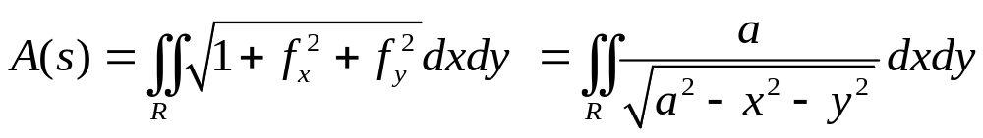
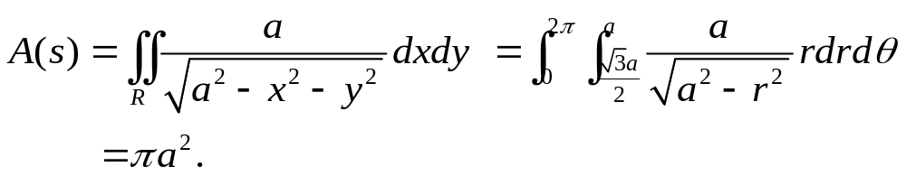
10.6 Surface Integrals
EXERCISE 2: Area of part of a Sphere (continued)
The area is obtained as
where the region R is as shown above.
Use change of variables to calculate the double integral:
with √3 a/2 ≤ r ≤ a and 0 ≤ θ ≤ 2π to cover the region R
Hence, (more details)
Section 10.6 p<number>

Slide 23
10.7 Triple Integrals.
Divergence Theorem of Gauss

Slide 24
Overview of Integrals and Integral Theorems
Definite integral
generalization
Line integral
One-dimensional integral
Green’s Theorem
Stokes’s Theorem
Double integral
generalization
Surface integral
Two-dimensional integral
Divergence Theorem
Three-dimensional integral
Triple integral

Slide 25
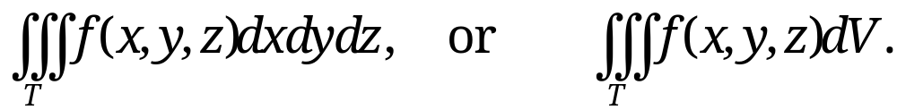
10.7 Triple Integrals. Divergence Theorem of Gauss
Triple Integrals
Triple integral is an integral of a scalar function f(x, y, z) taken over a closed bounded three-dimensional region T in space, denoted by
Assumptions for existence
  Integrand f is continuous in a domain containing T
  Region T is bounded by piecewise smooth surfaces
Interpretation: if f(x, y, z) is density, then triple integral is mass of the region T; in particular, if f(x, y, z)=1, then it is the volume of the region
Evaluation of triple integral by three successive integrations
Section 10.7 p<number>

Slide 26
10.7 Triple Integrals. Divergence Theorem of Gauss
Change of Variables in Triple Integrals.
Similar to double integrals, we can convert the integrand f(x, y, z) as a function of u, v, and w via the change of variables:
x = x(u, v, w), y = y(u, v, w), and z = z(u, v, w).
The formula for a change of variables in triple integrals from (x, y, z) to (u, v, w) is
where T* is the region in the uvw-plane corresponding to region T in the xyz-plane.
Section 10.7 p<number>

Slide 27
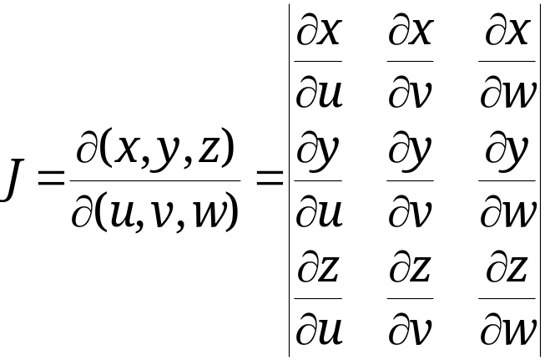
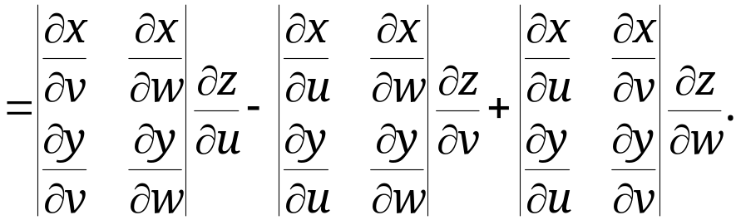
10.7 Triple Integrals. Divergence Theorem of Gauss
Change of Variables in Triple Integrals (continued)
Note: with the integrand expressed in terms of (u, v, w), dx dy dz is replaced by du dv dw times the absolute value of the Jacobian (TODO: further info ??)
The choice of (u, v, w) is based on both f(x, y, z) and the corresponding region T of integration, with the purpose of simplifying calculation
Section 10.7 p<number>

Slide 28
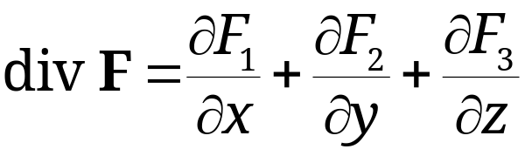
10.7 Triple Integrals. Divergence Theorem of Gauss
Divergence Theorem of Gauss
Triple integrals can be transformed into surface integrals over the boundary surface of a region in space and conversely
Such a transformation is of practical interest, since
  One of the two integrals is often simpler to calculate than the other;
  It helps establish fundamental equations in fluid flow, heat conduction, etc.
The transformation is done by the divergence theorem, which involves the divergence of a vector function F = [F₁, F₂, F₃] = F₁i + F₂ j + F₃k, namely,
(1) (Sec. 9.8)
Section 10.7 p<number>

Slide 29
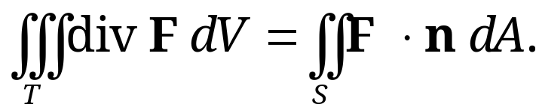
10.7 Triple Integrals. Divergence Theorem of Gauss
Theorem 1
Divergence Theorem of Gauss
(Transformation Between Triple and Surface Integrals)
Let T be a closed bounded region in space whose boundary is a piecewise smooth orientable surface S.
Let F(x, y, z) be a vector function that is continuous and has continuous first partial derivatives in some domain containing T.
Then, the following equation holds
(2)
Here, n is the outer unit normal vector, i.e., it points outside the closed boundary surface S.
Section 10.7 p<number>

Slide 30
10.7 Triple Integrals. Divergence Theorem of Gauss
Remarks:
Physical interpretation
  Suppose F = ρv, where ρ and v are fluid density and velocity field.
  Since div F measures the net outflow at each point (see sec. 9.8), LHS of (2) gives the aggregate net outflow of region T.
  RHS of (2) is flux integral, which gives flux flowing out across the boundary surface S of region T.
  Divergence theorem states that LHS of (2) equals RHS of (2), which is intuitive.
Proof of divergence theorem is given Here and can also be found at pages 454-456 in the textbook
Section 10.6 p<number>

Slide 31
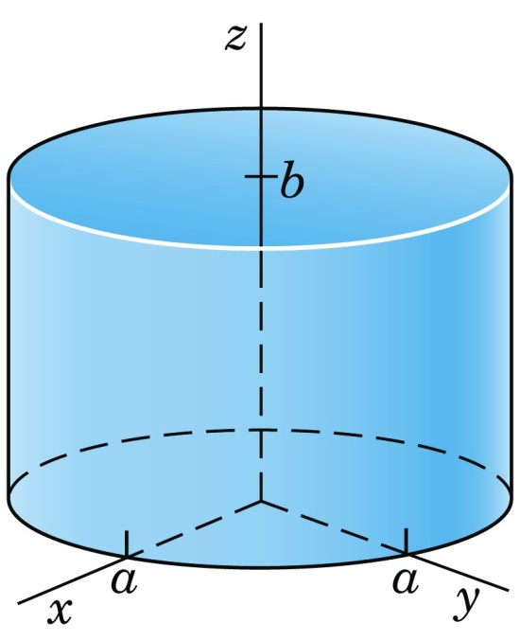
10.7 Triple Integrals. Divergence Theorem of Gauss
EXAMPLE 1 Verification of the Divergence Theorem
With F=[x³, x²y, x²z] and the cylinder of Fig. 252, verify that the divergence theorem (2) holds.
Fig. 252. Cylinder for Example 1
Cylindrical surface consists of 3 parts:
S1: top surface
S2: side surface
S3: bottom surface
Section 10.7 p<number>

Slide 32
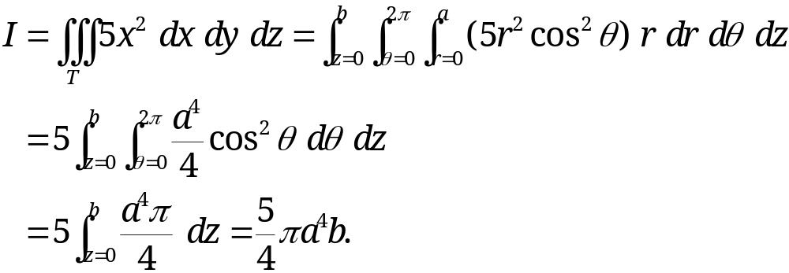
10.7 Triple Integrals. Divergence Theorem of Gauss
Computing the left hand side of (2):
div F = 3x² + x² + x² = 5x²
The form of the surface suggests polar coordinates r, θ defined by x = r cos θ, y = r sin θ (thus cylindrical coordinates r, θ, z)
Then, dx dy dz = r dr dθ dz, and we obtain,
Section 10.7 p<number>

Slide 33
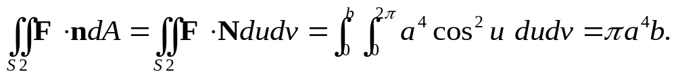
10.7 Triple Integrals. Divergence Theorem of Gauss
Computing the right hand side of (2):
The surface S has three parts: S1, S2 and S3 (Fig. 252).
For surface S2,
- Parametrize: x =a cos u, y=a sin u, and z = v. Hence,
Surface S2: r = [a cos u, a sin u, v] (0 ≤ u ≤ 2π, 0 ≤ v ≤ b).
- N = r_{u} × r_{v} = [- a sin u, a cos u, 0] × [0, 0, 1]
= [a cos u, a sin u, 0]. (Outward normal vector pointing sideway)
- Expressing F=[x³, x²y, x²z] in terms of u and v:
F(r (u, v))= [a ³ cos ³ u, a ³ cos² u sin u, a ² cos² u v].
- With F(r) ⋅ N = a ⁴ cos ² u , the flux integral is
Section 10.7 p<number>

Slide 34
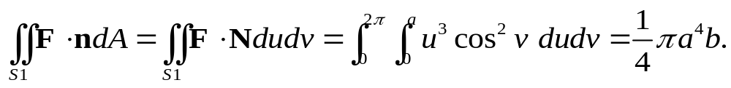
10.7 Triple Integrals. Divergence Theorem of Gauss
For surface S1,
- Parametrize: x =u cos v, y=u sin v, and z = b. Hence,
Surface S1: r = [u cos v, u sin v, b] (0 ≤ u ≤ a, 0 ≤ v ≤ 2π).
- N = r_{u} × r_{v} = [cos v, sin v, 0] × [-u sin v, u cos v, 0]
= [0, 0, u]. (Outward normal vector pointing up!)
- Expressing F=[ x³, x²y, x²z] in terms of u and v:
F(r (u, v))= [u ³ cos ³ v, u ³ cos² v sin v, u ² cos² v b].
- With F(r) ⋅ N = u ³ cos² v b, the flux integral is (Missing b!!)
Section 10.7 p<number>

Slide 35
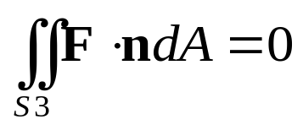
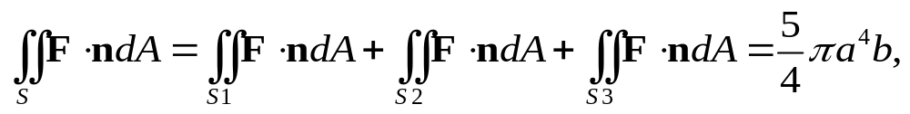
10.7 Triple Integrals. Divergence Theorem of Gauss
For surface S3,
- Parametrize: x =u sin v, y=u cos v, and z = 0. Hence,
Surface S3: r = [u sin v, u cos v, 0] (0 ≤ u ≤ a, 0 ≤ v ≤ 2π).
- N = r_{u} × r_{v} = [sin v, cos v, 0] × [u cos v, - u sin v, 0]
= [0, 0, -u]. (Outward unit normal vector pointing down!)
- Expressing F=[ x³, x²y, x²z] in terms of u and v:
F(r (u, v))= [u ³ cos ³ v, u ³ cos² v sin v, 0].
- With F(r) ⋅ N = 0, the flux integral is thus
Adding the flux integrals of S1, S2 and S3:
the same as the LHS, verifying the Divergence theorem!
Choose differently from S1 to yield the normal vector pointing down!
Section 10.7 p<number>

Slide 36
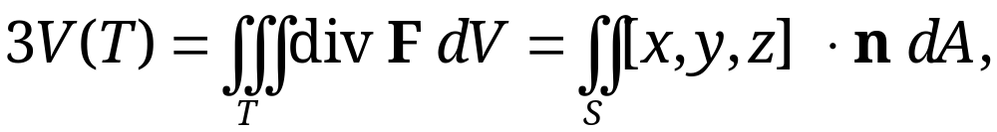
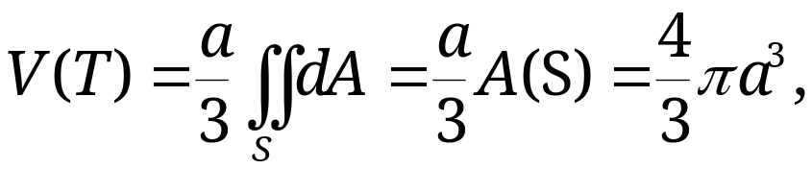
10.7 Triple Integrals. Divergence Theorem of Gauss
EXERCISE: Volume of a Ball
Evaluate the volume of the ball T: 0≤x²+y²+z² ≤ a² by using the divergence theorem.
Solution: Let F=[x, y, z]. Then, div F= 3. Applying divergence theorem, we have
where surface S is the sphere x²+y²+z² = a² and its unit normal vector n=[x, y, z]/a (see Sec. 10.5). Then, [x, y, z] ⋅ n = a. Thus,
where the last equation holds since A(S)=4πa² (see Sec. 10.6)
Section 10.7 p<number>

Slide 37
10.9 Stokes’s Theorem

Slide 38
Overview of Integrals and Integral Theorems
Definite integral
generalization
Line integral
One-dimensional integral
Green’s Theorem
Stokes’s Theorem
Double integral
generalization
Surface integral
Two-dimensional integral
Divergence Theorem
Three-dimensional integral
Triple integral

Slide 39
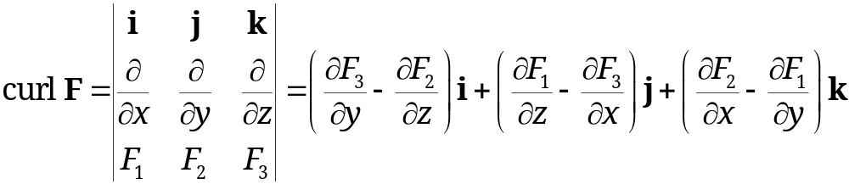
10.9 Stokes’s Theorem
In this section, we introduce another integral theorem, i.e., Stokes’s theorem, which allows us to transform between line integrals and surface integrals
Stokes’s theorem generalizes Green’s theorem in the plane (Note: double integral is a special case of surface integral)
Recall the definition of curl F
(1)
Section 10.9 p<number>

Slide 40
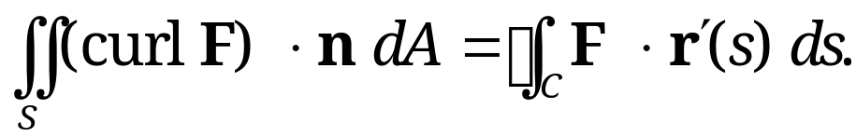
10.9 Stokes’s Theorem
Theorem 1
Stokes’s Theorem
(Transformation Between Surface and Line Integrals)
Let S be a piecewise smooth oriented surface in space and let its boundary be a piecewise smooth simple closed curve C
Let F be a continuous vector function with continuous first partial derivatives in a domain in space containing S
Then, we have
(2)
Here, n is a unit normal vector of surface S and, depending on n, the integration around C is taken in the sense shown in Fig. 254. Furthermore, r’(s) = dr/ds is the unit tangent vector and s is the arc length of C.
Section 10.9 p<number>

Slide 41
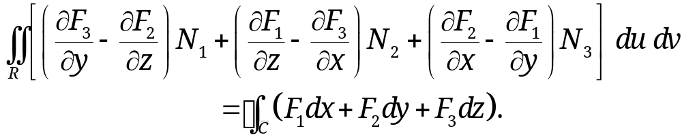


Theorem 1 (continued)
10.9 Stokes’s Theorem
In components, formula (2) becomes
(2*)
Here, F = [F₁, F₂, F₃], N = [N₁, N₂, N₃], n dA = N du dv, r’(s)ds = [dx, dy, dz], and R is the region with boundary curve in the uv-plane corresponding to surface S represented by r(u, v).
Fig. 254. Stokes’s theorem
Note: Proof of stokes’s theorem is given Here
Section 10.9 p<number>

Slide 42

10.9 Stokes’s Theorem
EXAMPLE 1 Verification of Stokes’s Theorem
With F=[y, z, x] and S the paraboloid (Fig. 255)
z=f(x, y)=1-(x²+y²), z≥0,
verify that the Stokes’s theorem (2) holds.
Solution: The curve C, oriented as in Fig. 255, is the circle r(s) =[cos s, sin s , 0], 0 ≤ s ≤ 2 π. F(r(s)) = [sin s , 0, cos s]. Hence,
Section 10.9 p<number>

Slide 43

10.9 Stokes’s Theorem
EXAMPLE 1 Verification of Stokes’s Theorem (cont’d)
We now consider the surface integral. A parametric presentation of surface S is given by
r(x, y) = [x, y, 1-x²-y²], with region R: 0 ≤ x²+y² ≤ 1.
Then, r_{x}(x, y) = [1, 0, -2x] and r_{y}(x, y) = [0, 1, -2y]. Thus,
N(x, y) = r_{x} × r_{y} = [2x, 2y, 1].
Since curl F = [-1, -1, -1], we have
Letting x=r cos θ and y=r sinθ, by change of variables, we have
Thus, the surface integral equals –π, which is the same as the line integral, verifying the Stokes’s theorem!
Section 10.9 p<number>

Slide 44


10.9 Stokes’s Theorem
EXAMPLE 2 Green’s Theorem in the Plane as a Special Case of Stokes’s Theorem
Let F = [F₁, F₂] = F₁ i + F₂ j be a vector function that is continuously differentiable in a domain in the xy-plane containing a simply connected bounded closed region S whose boundary C is a piecewise smooth simple closed curve. Then, according to (1),
Then, Stokes’s theorem reduces to Green’s theorem in the plane:
Section 10.9 p<number>

Slide 45
10.9 Stokes’s Theorem
EXAMPLE 3
Evaluation of a Line Integral by Stokes’s Theorem
Evaluate ∫_{C} F ⋅ r’ds, where C is the circle x² + y² = 4, z = –3, oriented counterclockwise as seen by a person standing at the origin, and, with respect to the right-handed Cartesian coordinates,
F = [y, xz³, –zy³] = yi + xz³j – zy³k.
Solution: As a surface S bounded by C we can take the plane circular disk x² + y² ≤ 4 in the plane z = –3. Then, n in Stokes’s theorem points in the positive z-direction; thus n = k.
Section 10.9 p<number>

Slide 46

10.9 Stokes’s Theorem
EXAMPLE 3 (continued)
Evaluation of a Line Integral by Stokes’s Theorem
Solution. (continued)
Hence, (curl F) ⋅ n is the component of curl F in the positive z-direction. Since F with z = –3 has the components F₁ = y, F₂ = –27x, F₃ = 3y³, we thus obtain
Hence the integral over S in Stokes’s theorem equals –28 times the area 4π of the disk S. This yields the answer
–28×4π = –112π.
(Confirm this by direct calculation, which involves more work.)
Section 10.9 p<number>

Slide 47

10.9 Stokes’s Theorem
Stokes’s Theorem Applied to Path Independence
Prove that the integral (9) is path independent in region D if D is simply connected and curl F = 0 everywhere in D.
(9)
Proof: Let C be any closed path in region D. Since D is simply connected, we can find a surface S in D bounded by C. Then, Stokes’s theorem applies and gives
for proper orientation on C and unit normal vector n on S.
Since curl F = 0 in D, the surface integral and hence the line integral are zero. This, together with Theorem 2 in Sec. 10.2 implies that the integral (9) is path independent in D.
Section 10.9 p<number>

